Slide 1
7/31 Updates
Weslee Nguyen

Slide 2
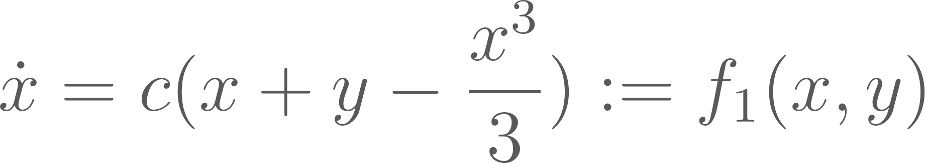
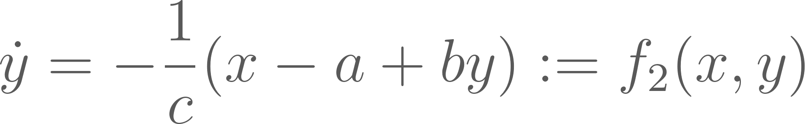
PROBLEM: Paper Not Reproducible
Treat cell as essentially one “conglomerated” neuron. Justifies FitzHugh-Nagumo Eqns and gives “physical meaning” to cells.
Membrane Potential: “Depolarization”
Thus need to plot this one!
Individual leg movement isn’t focus, so internal dynamics unnecessary. E.g. keep a, b, c same as focus is on gaits.
Recovery Variable: Return to RMP
↑ a = Longer hyperfractory period
↑ b = Returns to RMP faster
↑ c = Sharper spikes, slower recovery

Slide 3
PROBLEM: Paper Not Reproducible
λ = (a, b, c) kept fixed
Ipsilateral Couplings
Contralateral Couplings
IDEA: Promote / inhibit couplings in patterns that aligns with gait patterns.

Slide 4
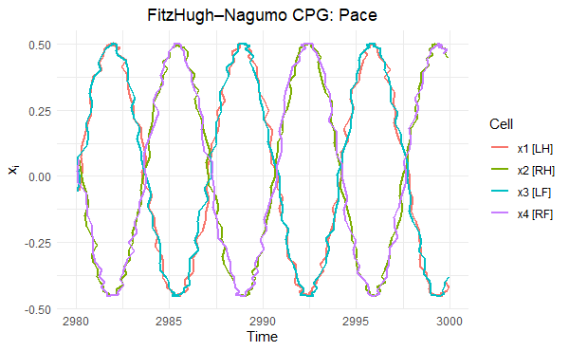
PACE
(ɑ,ꞵ,γ,δ) = (0.01, 0.01, -0.01, -0.01)
(+) Ipsilateral, (-) Contralateral
Jittered as otherwise x1 and x2 would overlap perfectly = invisible.

Slide 5
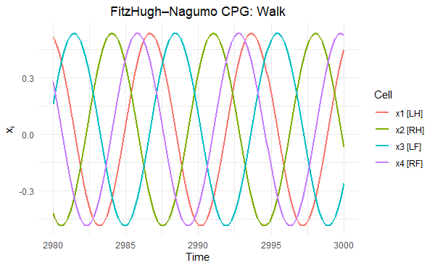
WALK / CANTER?
(ɑ,ꞵ,γ,δ) = (0.01, -0.01, -0.01, -0.01)
(+) Ipsilateral, (-) Contralateral

Slide 6
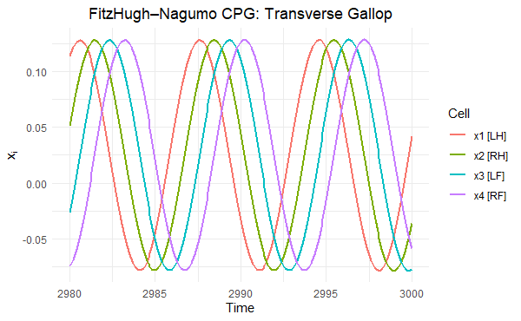
TRANSVERSE GALLOP
(ɑ,ꞵ,γ,δ) = (0.01, -0.01, -0.01, 0.01)
Neutral Ipsi- & Contralateral

Slide 7
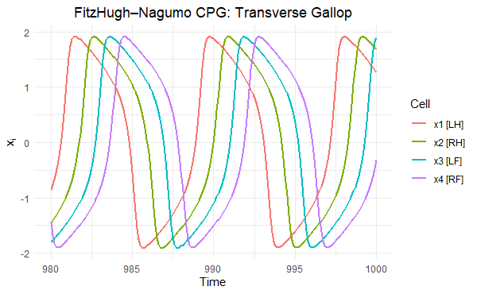
TRANSVERSE GALLOP
(ɑ,ꞵ,γ,δ) = (0.01, -0.01, -0.01, 0.01)
(a, b, c) = (0.02, 0.5, 2.4)

Slide 8
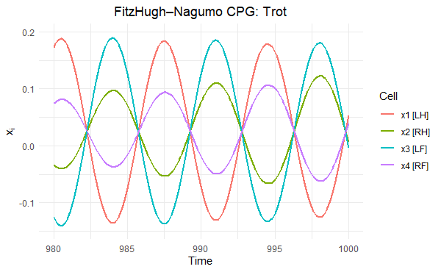
TROT?
(ɑ,ꞵ,γ,δ) = (-0.01, -0.01, 0.01, 0.01)
(-) Ipsilateral, (+) Contralateral
R crashes if I extend the time to see what it converges to, but it doesn’t seem to converge to Trot.

Slide 9
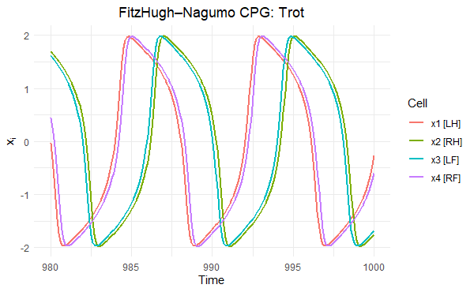
TROT?
(ɑ,ꞵ,γ,δ) = (0.01, -0.01, -0.01, 0.01)
c increased 0.44 to 2.4
Question mark is because the 2-beats should be evenly spaced. Converges to what’s shown.

Slide 10
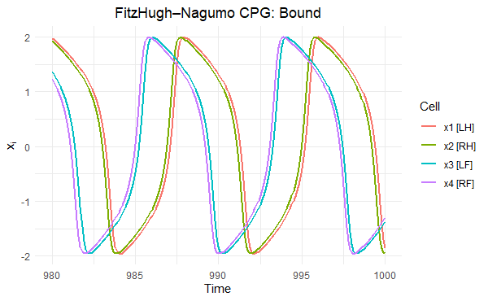
BOUND
(ɑ,ꞵ,γ,δ) = (0.01, -0.01, -0.01, 0.01)
c stays at 2.4, but a to 0.07
Not a natural gait, could simulate horse jumping over fences. Is accurate as horse begins / lands on front, then ends with back.

Slide 11
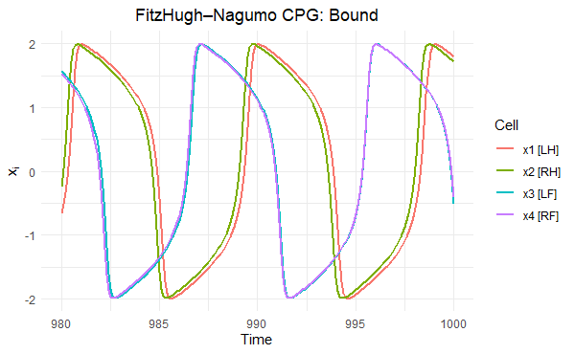
BOUND
(ɑ,ꞵ,γ,δ) = (0.01, -0.01, -0.01, 0.01)
c increased 0.44 to 3.1
a returns to 0.02

Slide 12
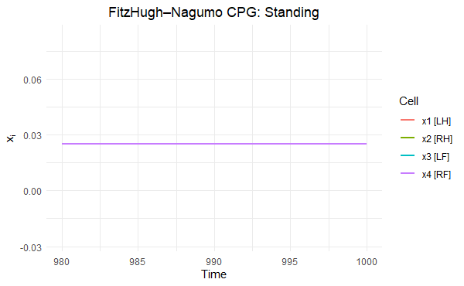
STAND
(ɑ,ꞵ,γ,δ) = (0.01, 0.01, 0.01, 0.01)
(+) Ipsi- & Contralateral
x1 and x3 are perfectly aligned with x4; shown if jittered.

Slide 13
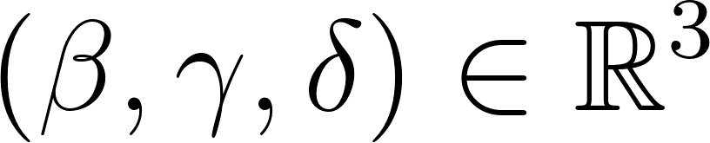
GAIT TABLE USED
 | c | ɑ | ꞵ | γ | δ
Pace | 0.44 | 0.01 | 0.01 | -0.01 | -0.01
Walk | 0.44 | 0.01 | -0.01 | -0.01 | -0.01
Transverse Gallop | 0.44 | 0.01 | -0.01 | -0.01 | 0.01
Trot | 2.4 | 0.01 | -0.01 | -0.01 | 0.01
Bound | 3.1 | 0.01 | -0.01 | -0.01 | 0.01
Stand | 0.44 | 0.01 | 0.01 | 0.01 | 0.01
Highlighted is those I selected for analysis. Thus limits to

Slide 14
8/1 Updates
Weslee Nguyen

Slide 15
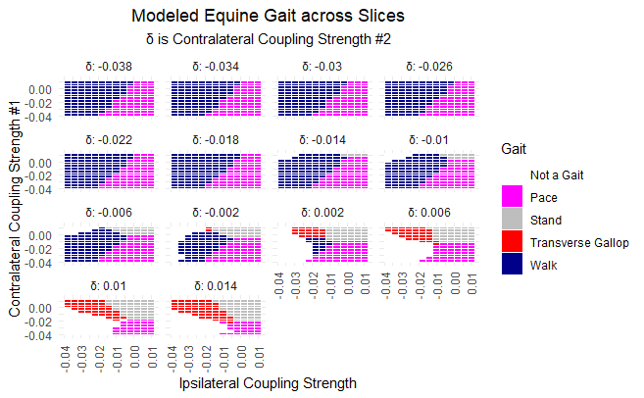
Notes:
Include alpha, beta, gamma, delta in both poster and paper
Consider having delta = 0.018, 0.022 to nicely extend to the plots visually a square put together
Poster & paper: Define symbols early, then only use symbols in the figure (e.g. just \alpha)
Could shrink font and make sure to change font to Times New Roman

Slide 16
Notes:
Consider QR code at poster session, but the first cube plot takes priority

Slide 17
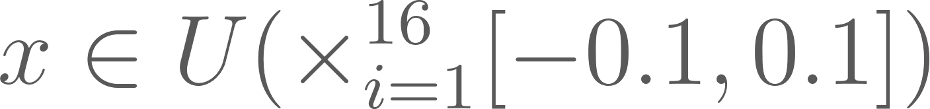
SENSITIVITY ANALYSIS
For Pace & Transverse Gallop
For Initial Conditions:
[RESULTS]
20/20 trials produced Pace
20/20 trials produced Transverse Gallop
Notes:
Could extend sensitivity analses to other conditions e.g. stand or different parameters for pace

Slide 18
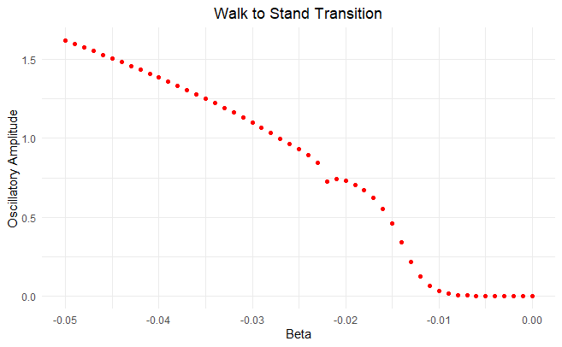
Notes:
Keep track if I had to extend convergence time
Algorithm needs another checkpoint: if it converged, run another model for k = k + 1 to see if maxes / mins stays stable
Tolerance Parameter: Decrease to see if that changes the graph / by how much (0.01? 0.001?)

Slide 19
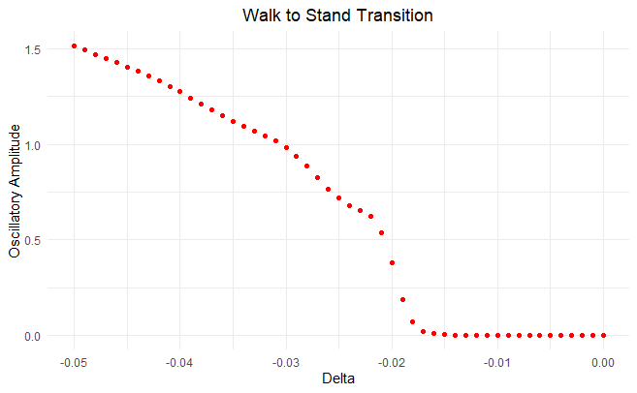
Notes:
Look at more gait transitions e.g. stand v. walk v. transverse gallop v. pace

